Slide 1
Edge-bipancyclicity of star graphs under edge-fault tolerant
Min Xu, Xiao-Dong Hu, Qiang Zhu
Applied Mathematics and Computation 183 (2006) 972–979
Presenter: Chiao-Wei Chiu
Date: Nov. 14, 2007

Slide 2
Abstract
The star graph S_{n} is one of the most famous interconnection networks. It has been shown by Li_{[8]}, that S_{n} contains a cycle of length from 6 to n! when the number of fault edges in the graph does not exceed n - 3. In this paper, we improve this result by showing that for any edge subset F of S_{n} with |F| ≦ n - 3 every edge of S_{n} - F lies on a cycle of every even length from 6 to n! provided n ≧ 3.

Slide 3
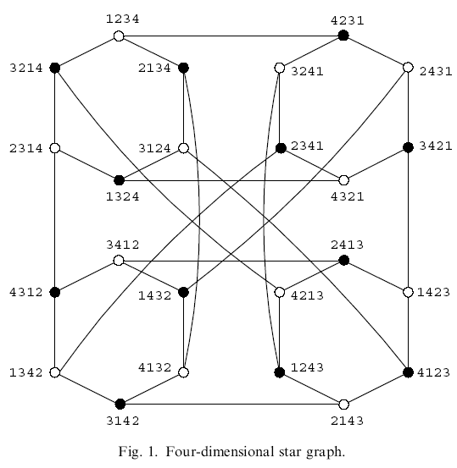
The star graph
There are n vertex-disjoint S_{n-1}’s in S_{n}
for n ≧ 2.

Slide 4
Hamiltonian laceable
A Hamiltonian bipartite graph is Hamiltonian laceable if there is a Hamiltonian path between any two vertices in different bipartite sets.

Slide 5
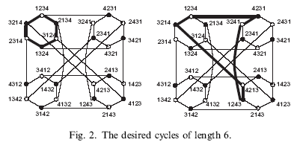
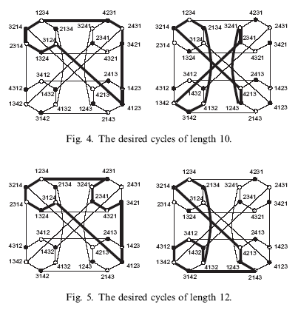
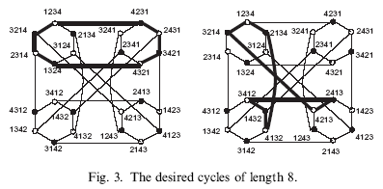
For any edge e and e’ of S₄, there exists a cycle of even length from 6 to 24 in S₄- e’ containing e.

Slide 6
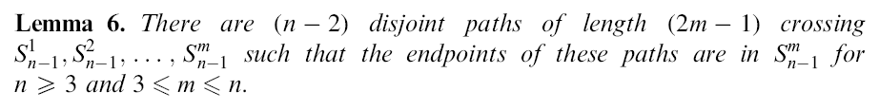

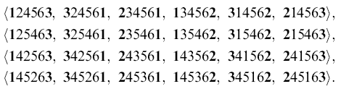
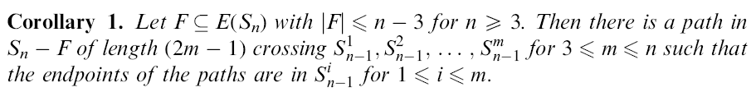
The endpoints of these paths are adjacent for m = 3, 4.
e.g. n = 6, m = 3

Slide 7

Theorem
For any edge subset F of S_{n} with |F| ≦ n - 3 and any edge e S_{n}- F, there exists a cycle of even length from 6 to n! in S_{n}- F containing e provided n ≧ 3.

Slide 8
Proof
For n = 3,4, the theorem holds
Assume now that the theorem is true for all integer k, 3 ≦ k < n.
Since S_{n} is vertex-symmetric and edge-symmetric, we assume that e = (a₁a₂…a_{i}…a_{n}, a_{i}a₂…a₁…a_{n})
We need to show that there exists a cycle of length l in S_{n}- F containing e.
  Case 1. 6 ≦ l ≦ (n - 1)!
  Case 2. (n - 1)! + 2 ≦ l ≦ 3(n - 1)!
  Case 3. 3(n - 1)! + 2 ≦ l ≦ n!

Slide 9
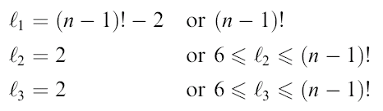
Case 2. (n - 1)! + 2 ≦ l ≦ 3(n - 1)!
we can write l = l₁ + l₂ + l₃ where l₁ ≧ l₂ ≧ l₃ and the following restrictions should be satisfied:
There exists a cycle of length 6 crossing subgraphs S^{an} _{, S}^{j} _{, S}^{k}
Replace the edge e’ by the cycle in S^{an} _{, S}^{j} _{, S}^{k}

Slide 10
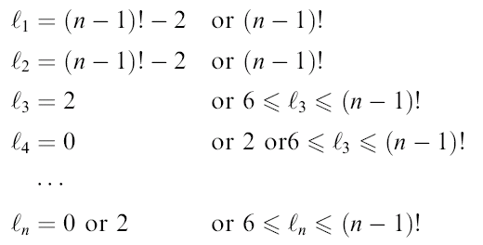
Case 3. 3(n - 1)! + 2 ≦ l ≦ n!
we can write l = l₁ + l₂ + l₃ + … + l_{n} where l₁ ≧ l₂ ≧ l₃ ≧ … ≧ l_{n} and the following restrictions should be satisfied:
There exists a path of length (2m - 1) crossing S¹ _{,…, S}^{m} _{and the endpoints are in S}^{i}

